Slide 1
Introduction of Fabric

Slide 2
Capabilities
Capabilities of Microsoft fabric are
Role-specific workloads: Customized solutions for various roles within an organization, providing each user with the necessary tools.
OneLake: A unified data lake that simplifies data management and access.
Copilot support: AI-driven features that assist users by providing intelligent suggestions and automating tasks.
Integration with Microsoft 365: Seamless integration with Microsoft 365 tools, enhancing collaboration and productivity across the organization.
Azure AI Foundry: Utilizes Azure AI Foundry for advanced AI and machine learning capabilities, enabling users to build and deploy AI models efficiently.
Unified data management: Centralized data discovery that simplifies governance, sharing, and access.

Slide 3
Different services
Let’s look at the problem, Fabric is solving
Prior to Fabric organization used different data tools and services for data ingestion, Orchestration, Engineering, Real time and data science workloads.
Fabric provides one possible architecture Using Azure cloud services.

Slide 4
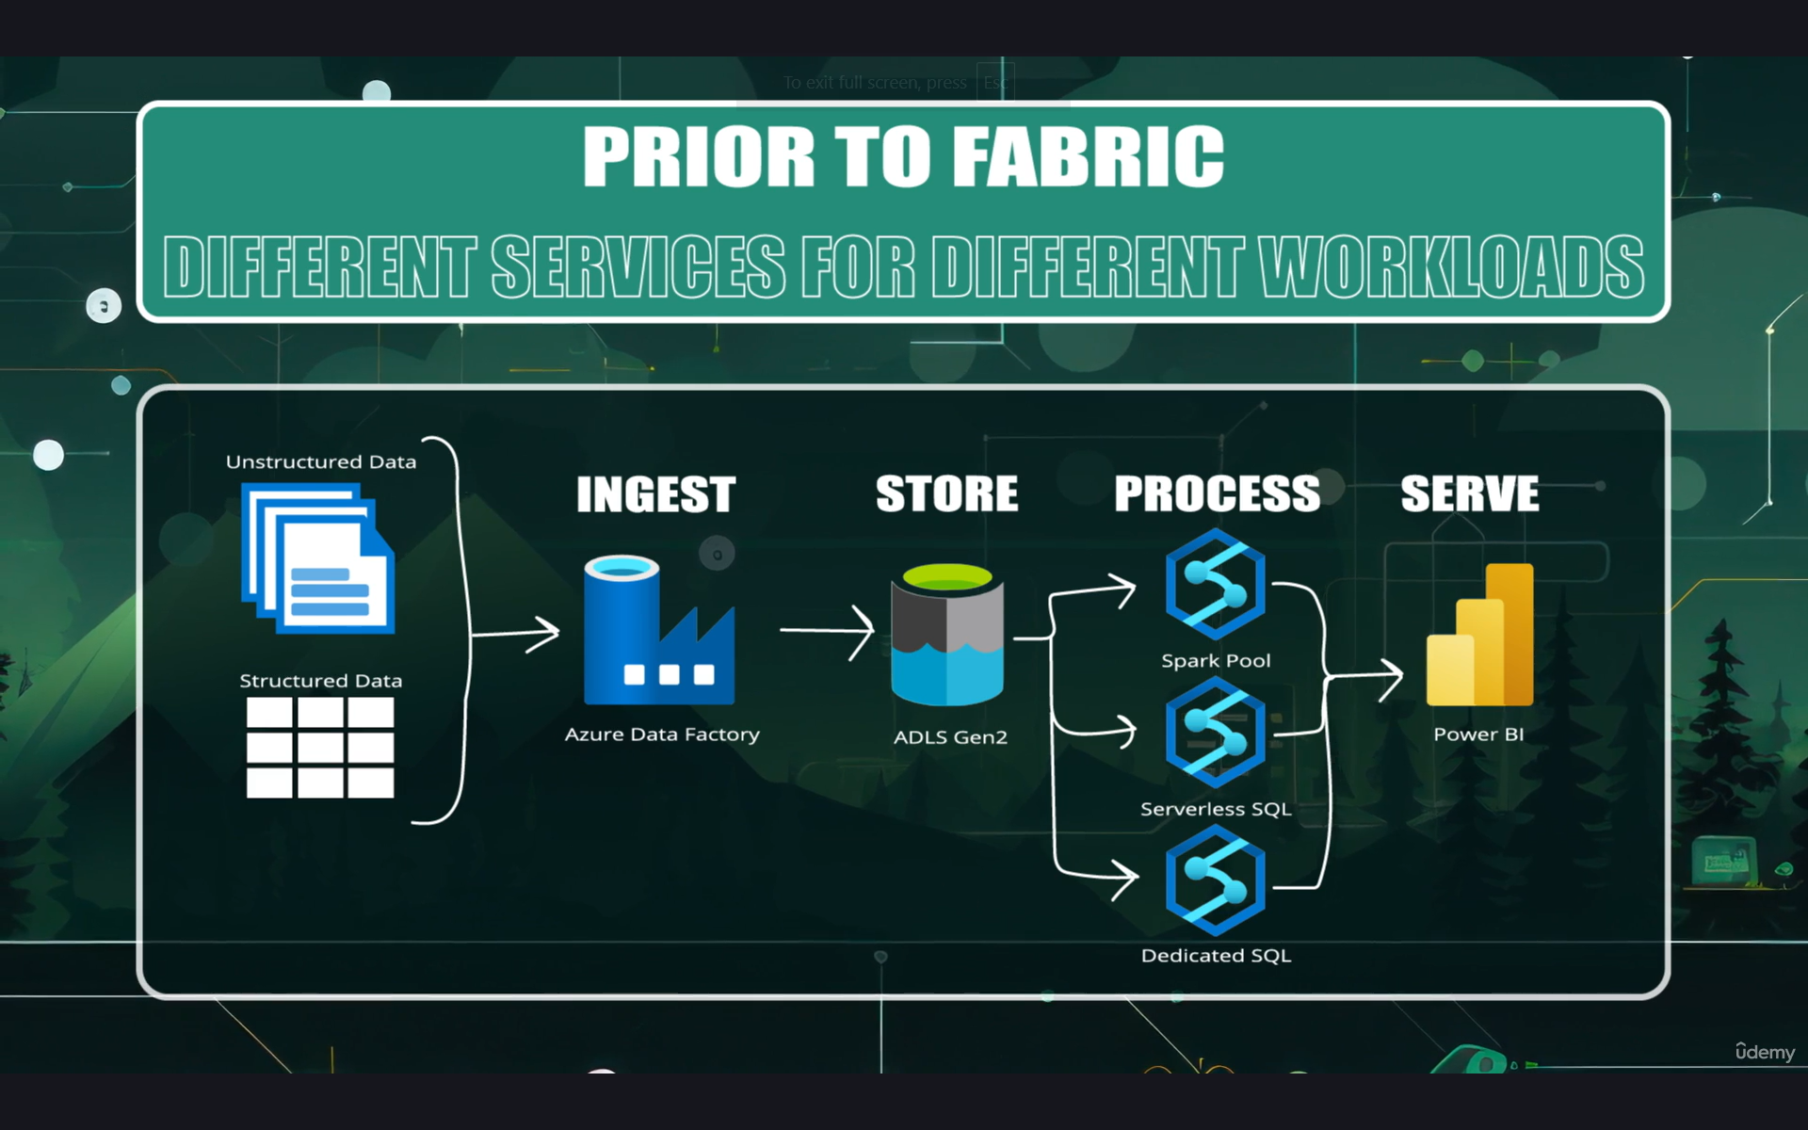

Slide 5
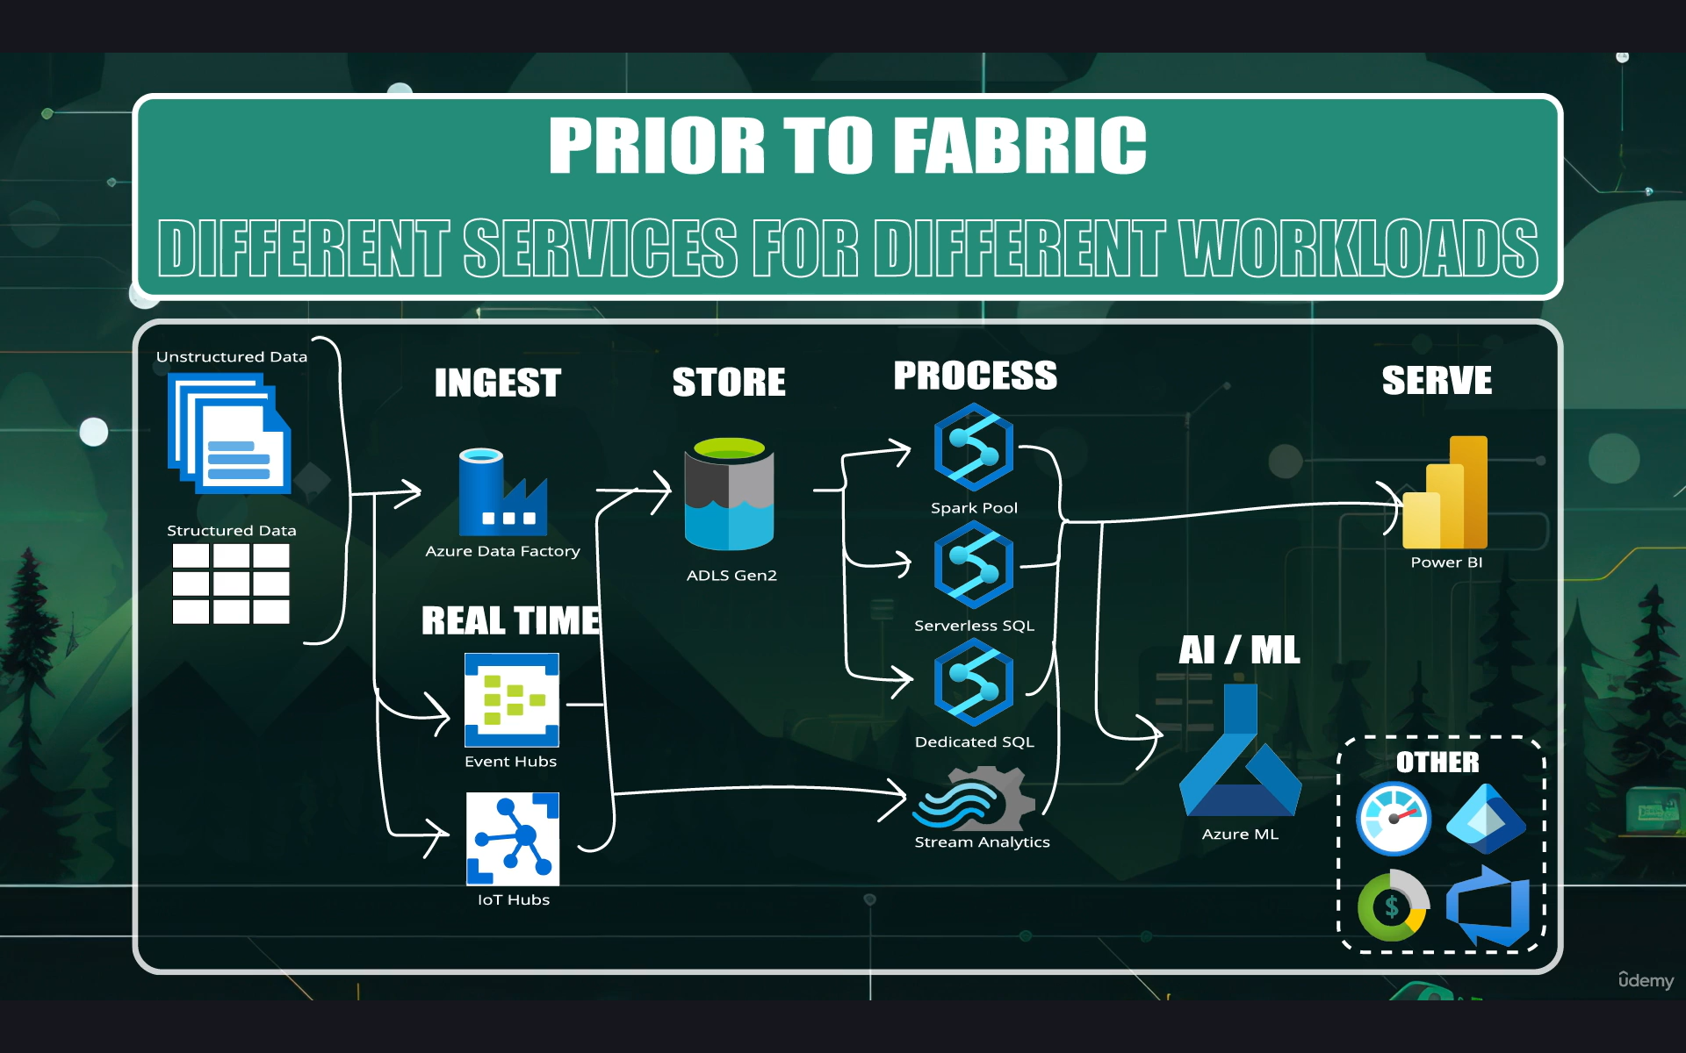

Slide 6
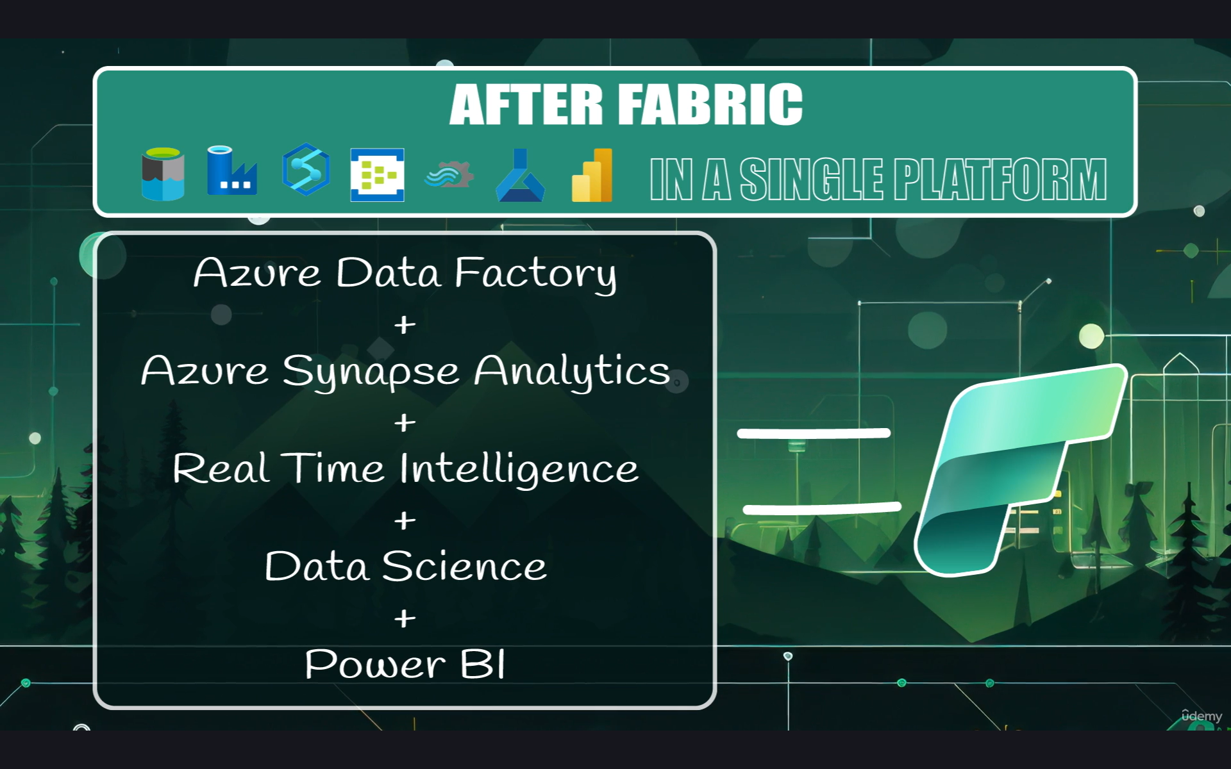

Slide 7
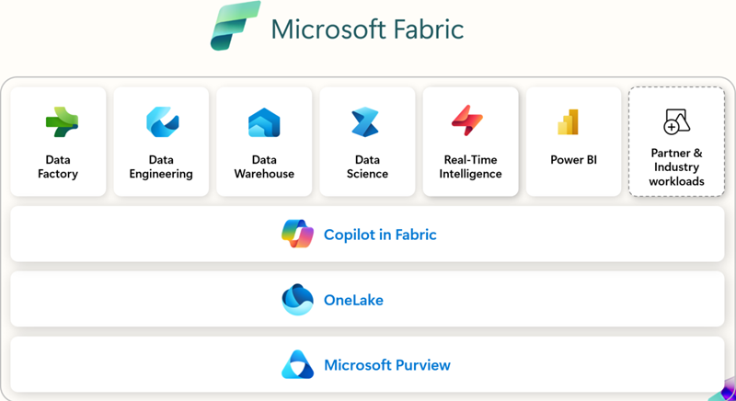

Slide 8
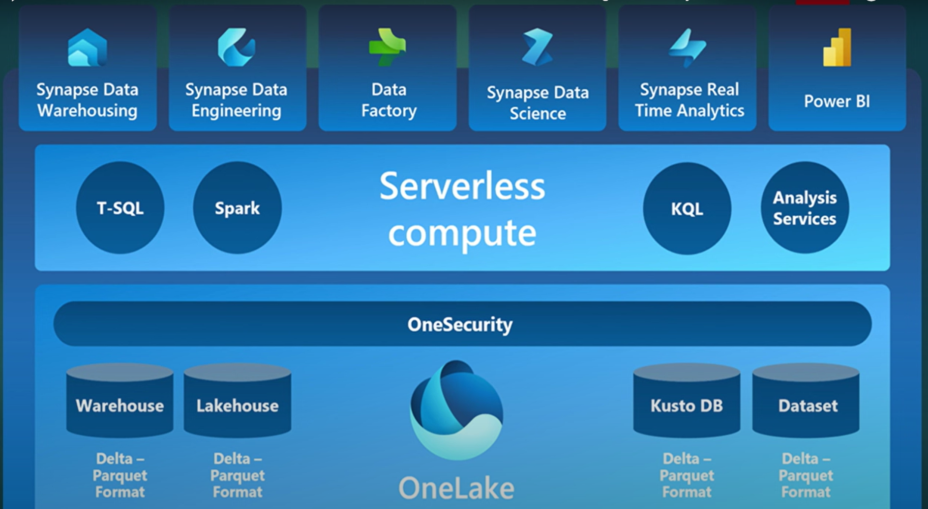

Slide 9
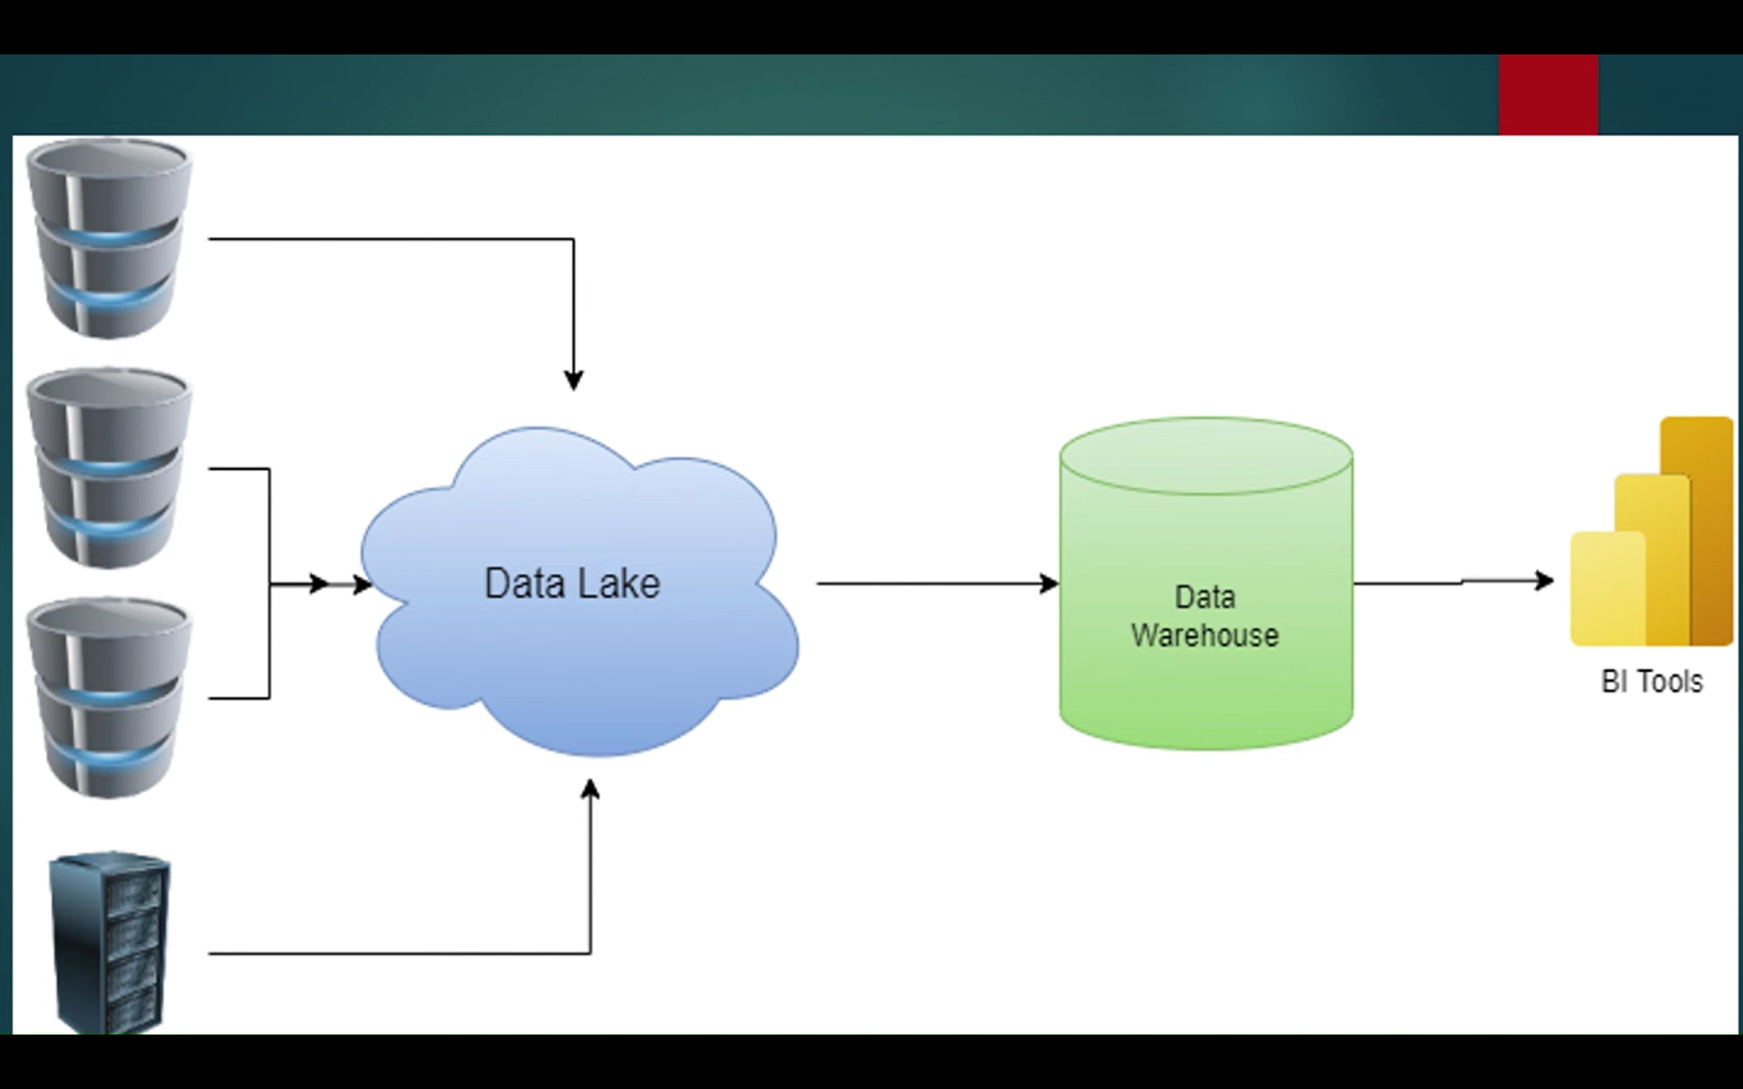

Slide 10
Create user
Search for the user and create the new user
Once the user id created, click on the user -> assigned roles -> Add assignments
Search for the global administrator -> add

Slide 11
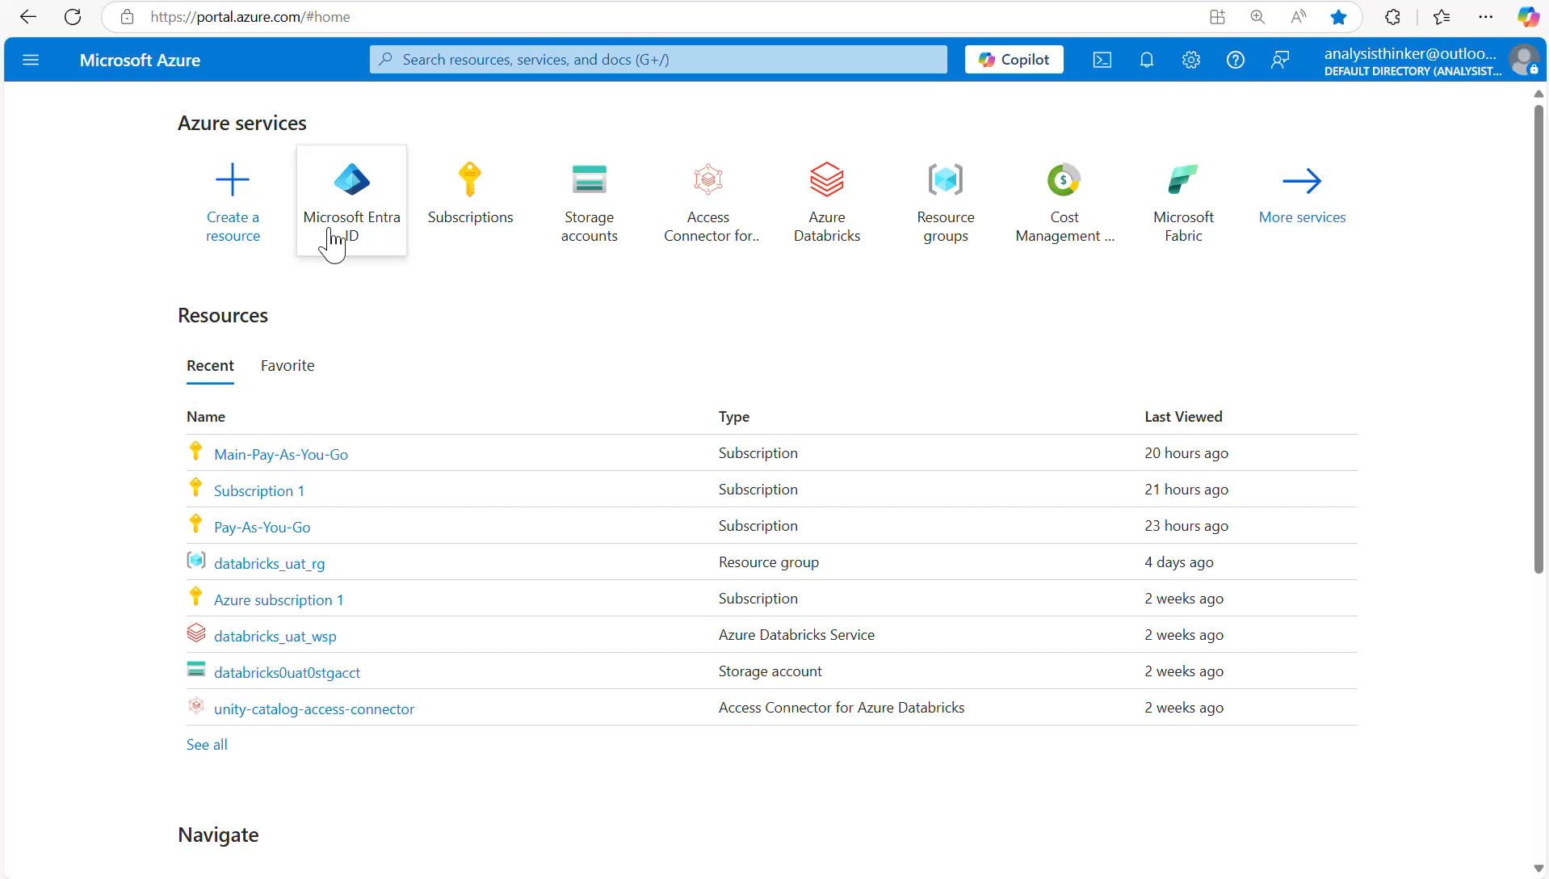

Slide 12
Subscription
Go to the subscription -> IAM
Add -> Role assignment -> Privileged administrator role ->Owner
Click on next and Assign access to User group or service principal
Click on the Select members and select the user which is created just now
Click next and control will be on conditions tab ->
User Field “what users can do” select “allow users to assign all roles”
Now sign out of the main account and login using another account which is created just now.

Slide 13
https://github.com/DEVWORK2025/fabric_dev_2026/blob/main/working_with%20account_opening.mp4

